Slide 1
Business Intelligence G. Mudare

Slide 2
Cluster Analysis
In Cluster analysis ,unlike in classification, the class label of each object is not known.(unsupervised learning)
Clustering is the process of grouping the data into classes or clusters, so that objects within a cluster have high similarity in comparison to one another but are very dissimilar to objects in other clusters.
The objective is to divide the objects into homogeneous and distinct groups.
Dissimilarities are assessed based on the attribute values describing the objects.
Observations within each group are similar to one another with respect to variables or attributes of interest, and the groups themselves Stand apart from one another.

Slide 3
Cluster Analysis Explained
In clustering you first partition the set of data into groups based on data similarity and then assign labels to the relatively small number of groups.
In contrast to the classification problem where each observation is known to belong to one of a number of groups and the objective is to predict the group to which a new observation belongs, cluster analysis seeks to discover the number and composition of the groups.
Classification tries to predict the label of (unlabeled) data.
Clustering is grouping things into “natural” categories when no class label is available
Clustering is unsupervised learning.
Need to automatically decide on the grouping structure

Slide 4
Why clustering?
Labeling a large set of sample patterns can be costly.
The contents of the database may not be known.
Clustering can be used for finding features that will later be useful for categorization.
It may help to gain insight into the nature of the data.
It may lead to discovery of distinct subclasses or similarities among patterns.

Slide 5
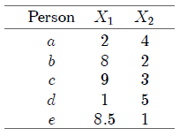
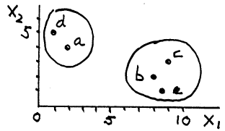
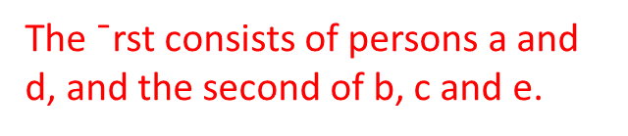
Cluster Analysis Example
Cluster analysis embraces a variety of techniques, the main objective of which is to group observations or variables into homogeneous and distinct clusters.
A simple numerical example will help explain these objectives.
The daily expenditures on food (X1) and clothing (X2) of five persons

Slide 6
Clustering Challenges
What cost function to use?
What underlying structure to assume?
How to measure similarity?
How to decide on the number of clusters?
Different answers to these questions may lead to different clustering algorithms and different clustering outcomes.
Common objective: generalize well.

Slide 7

Clustering General approach for learning
For a given set of points, x_{i} , i Ꞓ {1, . . . ,N} learn a class Assignment y_{i} Ꞓ {1, . . . ,K} for each data point.
Describe each cluster c using a set of parameters .Ꝋ_{c}
Use an objective (cost) function to measure the quality of clustering.
A function of model parameters and assignment variables.
f(O, Y )
Clustering is the process of optimizing the objective function.

Slide 8
Applications of Clustering
Clustering has wide applications in
Market research, pattern recognition, data analysis, and image processing
Help marketers discover distinct groups in their customer bases and characterize customer groups based on purchasing patterns
Identification of areas of similar land use
In an earth observation database
The identification of groups of houses in a city according to house type, value, and geographic location,
The identification of groups of automobile insurance policy holders with a high average claim cost.
Help classify documents on the web for information discovery
used for outlier detection (detection of credit card fraud and the monitoring of criminal activities in electronic commerce.

Slide 9
Requirements of clustering in data mining:
Scalability: Clustering on a sample of a given large data set may lead to biased results. Highly scalable clustering algorithms are needed.
Ability to deal with different types of attributes: applications may require clustering other types of data different from numeric,, such as binary, categorical (nominal), and ordinal data, or mixtures of these data types.
Discovery of clusters with arbitrary shape:Many clustering algorithms determine clusters based on Euclidean or Manhattan distance measures. It is important to develop algorithms that can detect clusters of arbitrary shape.
Minimal requirements for domain knowledge to determine input parameters: Many clustering algorithms require users to input certain parameters in cluster analysis. Parameters are often difficult to determine, especially for data sets containing high-dimensional objects, makes the quality of clustering difficult to control

Slide 10
Requirements of clustering in data mining
Ability to deal with noisy data:Some clustering algorithms are sensitive to such data and may lead to clusters of poor quality.
Incremental clustering and insensitivity to the order of input records: develop incremental clustering algorithms and algorithms that are insensitive to the order of input. Some clustering algorithms cannot incorporate newly inserted data
High dimensionality: Finding clusters of data objects in high dimensional space is challenging,
Constraint-based clustering: Real-world applications may need to perform clustering under various kinds of constraints. The challenging task is to find groups of data with good clustering behavior that satisfy specified constraints.
Interpretability and usability: Users expect clustering results to be interpretable, comprehensible,and usable.

Slide 11
Approaches to cluster analysis
There are a number of clustering methods:
Hierarchical methods
Agglomerative methods, in which subjects start in their own separate and end, with the optimum number of clusters .
Divisive methods, in which all subjects start in the same cluster and the above strategy is applied in reverse until every subject is in a separate cluster
Non-hierarchical methods (often known as k-means clustering methods)

Slide 12
Clustering Algorithms
Clustering algorithms may be classified as listed below:
Exclusive Clustering> data are grouped in an exclusive way, so that if a certain datum belongs to a definite cluster then it could not be included in another cluster
Overlapping Clustering>uses fuzzy sets to cluster data, so that each point may belong to two or more clusters with different degrees of membership
Hierarchical Clustering>algorithm is based on the union between the two nearest clusters. The beginning condition is realized by setting every datum as a cluster. After a few iterations it reaches the final clusters wanted.
Probabilistic Clustering> uses a completely probabilistic approach.

Slide 13
Clustering Algorithms
Each of these algorithms belongs to one of the clustering types :
K-means is an exclusive clustering algorithm,
Fuzzy C-means is an overlapping clustering algorithm,
Hierarchical clustering is Hierarchical Clustering
Mixture of Gaussian is a probabilistic clustering algorithm

Slide 14
Types of Data in Cluster Analysis
Data matrix (or object-by-variable structure):objects, such as persons, with p variables (also called measurements or attributes), such as age, height, weight, gender, and so on.
Dissimilarity matrix (or object-by-object structure): This stores a collection of proximities that are available for all pairs of n objects. often represented by an n-by-n table:

Slide 15
Types of data and measures of distance
The data used in cluster analysis can be interval, ordinal or categorical.
Having a mixture of different types of variable will make the analysis more complicated.
In cluster analysis we need to have some way of measuring the distance between observations and the type of measure used will depend on what type of data you have.
A number of different measures have been proposed to measure ’distance’ for binary and categorical data

Slide 16
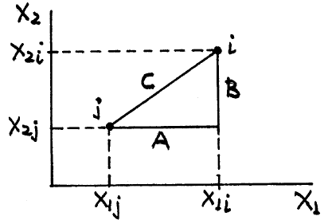

Types of data and measures of distance
Clustering methods require a more precise definition of “similarity" (“closeness", “proximity") of observations and clusters.
When the grouping is based on variables, it is natural to employ the familiar concept of distance.
For interval data the most common distance measure used is the Euclidean distance.
The Euclidean distance between the two points is the hypotenuse of the triangle ABC:

Slide 17
Types of data and measures of distance
An alternative measure is the squared Euclidean distance.
The squared distance between the two points i and j is
Another measure is the city block distance, defined as
Distance you travel if the points i and j were located at opposite corners of a city block
Distance measures can be extended to more than two variables

Slide 18
Types of data and measures of distance (hierarchical agglomerative clustering methods
Given a distance measure, a reasonable procedure for grouping n observations proceeds in the following steps:
Begin with as many clusters as there are observations, that is, with each observation forming a separate cluster
Merge that pair of observations that are nearest one another, leaving n -1 clusters for the next step.
Next, merge into one cluster that pair of clusters that are nearest one another, leaving n - 2 clusters for the next step.
Continue in this fashion, reducing the number of clusters by one at each step, until a single cluster is formed consisting of all n observations.
At each step, keep track of the distance at which the clusters are formed.

Slide 19
Euclidean distance
The problem with this procedure is how to measure the distance between clusters consisting of two or more observations.
the simplest method is to treat the distance between the two nearest observations, one from each cluster, as the distance between the two clusters.
This is known as the nearest neighbor (or single linkage) method
Euclidean distance is the
appropriate measure of proximity.

Slide 20
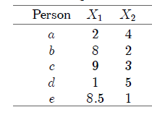
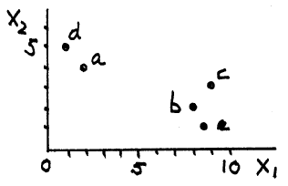
Euclidean distance

Slide 21
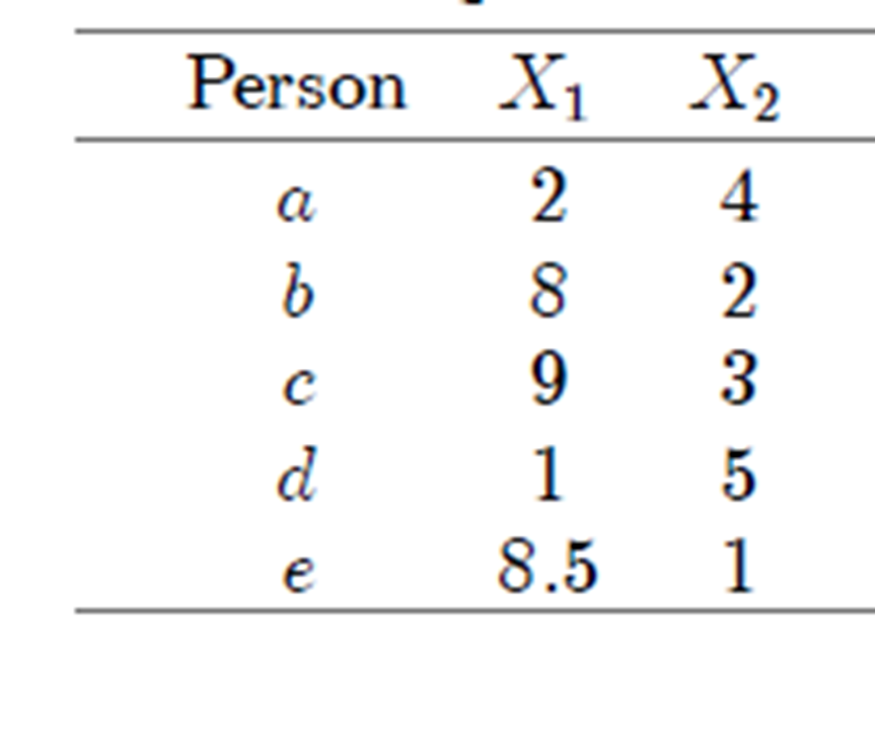

Euclidean distance
to determine the number of clusters, consider the step(s) at which the merging distance is relatively large.
distance between a and b is

Slide 22
Fill in the stars

Slide 23
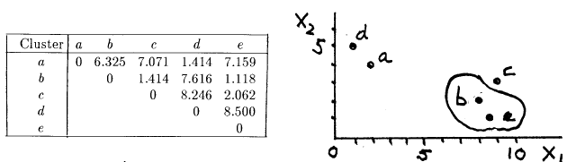
Euclidean distance
Observations b and e are nearest (most similar)

Slide 24
Nearest neighbor method
Assuming the nearest neighbor method is used, the distance between
The cluster (be) and another observation is the smaller of the distances between that observation, on the one hand, and b and e, on the other
Two pairs of clusters are closest to one another at distance 1.414; these are (ad) and (bce).

Slide 25
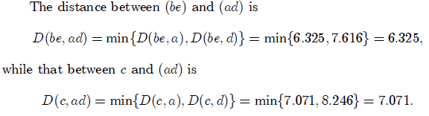
Nearest neighbor method
select (a;d) as the new cluster

Slide 26


Nearest neighbor method

Slide 27
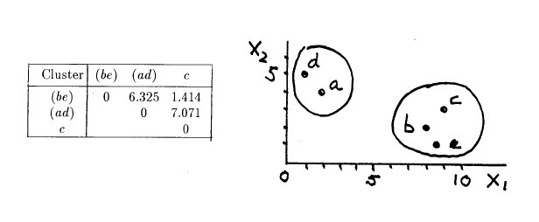
Nearest neighbor method

Slide 28
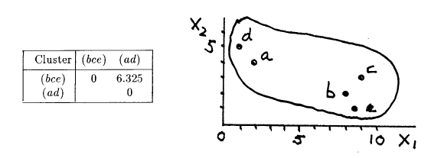
Nearest neighbor method

Slide 29
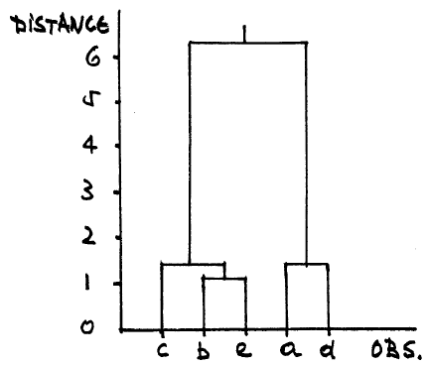
Nearest neighbor method, dendrogram
The groupings and the distance at which these took place are also shown in the tree diagram (dendrogram)

Slide 30
Cluster distance, furthest neighbor method
The nearest neighbor is not the only method for measuring the distance between clusters.
Under the furthest neighbor (or complete linkage) method, the distance between two clusters is the distance between their two most distant members.

Slide 31

Cluster distance, furthest neighbor method
The furthest neighbor method also calls for grouping b and e at step 1.
However, the distances between (be), on the one hand, and the clusters (a), (c), and (d), on the other, are different:

Slide 32
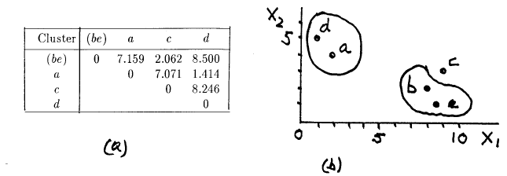
Cluster distance, furthest neighbor method

Slide 33
Cluster distance, furthest neighbor method
The nearest clusters are (a) and (d), which are now grouped into the cluster (ad).
the nearest and furthest neighbor methods produced the same results in this example.
In other cases, however, the two methods may not agree.

Slide 34
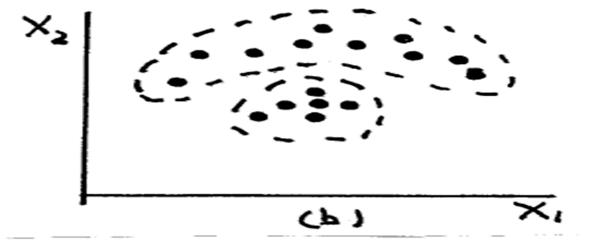
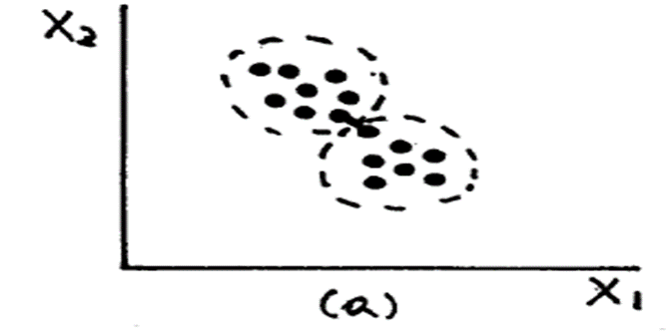
Cluster distance, furthest neighbor method
The nearest neighbor method will probably not form the two groups percived by the naked eye.
This is so because at some intermediate step the method will probably merge the two “closest" points joined into the same cluster, and proceed to string along the remaining points in chain-link fashion
The furthest neighbor method, will probably identify the two clusters because it tends to resist merging clusters the elements of which vary substantially in distance from those of the other cluster.
On the other hand, the nearest neighbor method will probably succeedd in forming the two groups marked

Slide 35
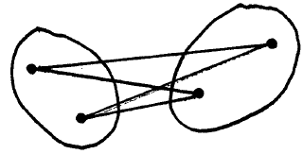
Average Linkage
A compromise method is average linkage, under which the distance between two clusters is the average of the distances of all pairs of observations, one observation in the pair taken from the first cluster and the other from the second cluster
.

Slide 36
Hierarchical divisive method
This method follows the reverse procedure in that it begins with a single cluster consisting of all observations, forms next 2, 3, etc. clusters, and ends with as many clusters as there are observations

Slide 37
Non-hierarchical clustering method, (k-means method)
Step 1. Specify the number of clusters and, arbitrarily or deliberately, the members of each cluster.
Step 2. Calculate each cluster’s “centroid" and the distances between each observation and centroid. If an observation is nearer the centroid of a cluster other than the one to which it currently belongs, re-assign it to the nearer cluster.
Step 3. Repeat Step 2 until all observations are nearest the centroid of the cluster to which they belong.
Step 4. If the number of clusters cannot be specified with confidence in advance, repeat Steps 1 to 3 with a different number of clusters and evaluate the results

Slide 38
(k-means method)
Suppose two clusters are to be formed
First assign a, b and d to Cluster 1,
Next assign c and e to Cluster 2.
Calculate cluster centroids
The cluster centroid is the point with coordinates equal to the average values of the variables for the observations in that cluster
Centroid of Cluster 1 is the point (X1 = 3:67, X2 = 3:67),

Slide 39
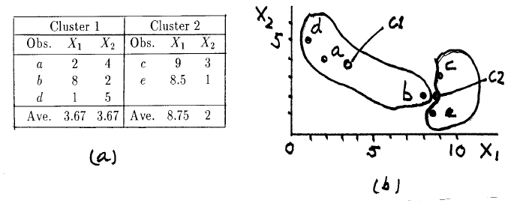


(k-means method)
The cluster centroid is the point with coordinates equal to the average values of the variables for the observations in that cluster.
calculate the distance between a
and the two centroids:
a is closer to the centroid of Cluster 1, to which it is currently assigned. a is not reassigned
Next, calculate the distance
between b and the two cluster centroids:
Since b is closer to Cluster 2's centroid than to that of Cluster 1, it is reassigned to Cluster 2.

Slide 40
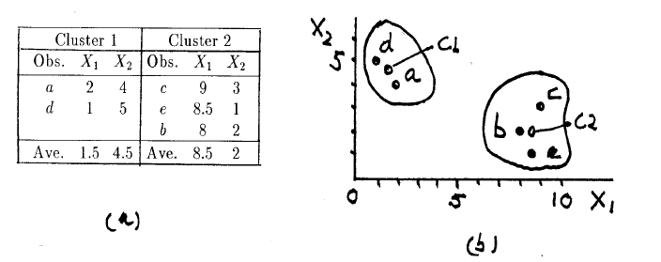
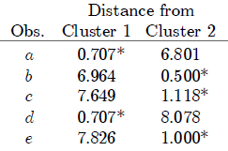
(k-means method)
New cluster centroids
Every observation belongs to the cluster to the centroid of which it is nearest, and the k-means method stops

Slide 41
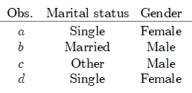

DISTANCE MEASURES FOR ATTRIBUTES
description of four persons according to marital status (single, married, divorced, other) and gender (male,female):
A reasonable measure of the similarity of two observations is the ratio of the number of matches (identical categories) to the number of attributes.

Slide 42
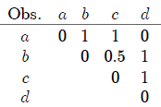
DISTANCE MEASURES FOR ATTRIBUTES
Since a and d are both single and female, the similarity measure is 2/2 or 1; b and c do not have the same marital status but are both male, so the similarity measure is 1/2.
The distances between all pairs of observations in our example are as follows:
Any of the clustering methods described earlier can be applied to the above distances. nearest neighbor, furthest neighbor, or complete linkage methods a and d would be grouped to form the first cluster.

Slide 43
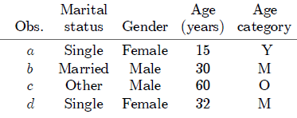
DISTANCE MEASURES FOR ATTRIBUTES
When the grouping is to be based on variables and attributes the simplest approach is to convert the variables to attributes and then apply the measure D_{a}(i; j) to the distance between any pair of observations
Say the four observations will be grouped according to marital status, gender, and age:

Slide 44

DISTANCE MEASURES FOR ATTRIBUTES
If we make age an attribute with, three categories: Y (under 25 years old), M (25 to 50), and O (more than 50 years old).
The “distance" between b and c, is
What will be the distances between all pairs of observations?

Slide 45
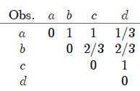
DISTANCE MEASURES FOR ATTRIBUTES

Slide 46
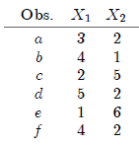
Question
Six observations on two variables are available, as shown in the following table:
Plot the observations in a scatter diagram. How many groups would you say there are, and what are their members?
Apply the nearest neighbour method and the squared Euclidean distance as a measure of dissimilarity. Use a dendrogram to arrive at the number of groups and their membership.
Apply the k-means method, assuming that the observations belong to two groups and that one of these groups consists of a and e.

